Slide 1
ASD
(Autism Spectrum Disorder)
SSLD Intervention
Ka Tat Tsang
2017

Slide 2
Autistic Spectrum Disorder (ASD)
Autism (Kanner 1943)
Asperger’s Syndrome (Asperger 1944)
Impaired development of social skills
  Social interaction: withdrawal, disengagement
  Processing of interpersonal information (e.g., empathy, understanding other’s point of view, reciprocity)
  Interpersonal communication
Atypical behavior：repetition, self-injury, aggression
Dysfunctional relationship with objects：obsession with sameness, particular manipulation, over-reaction, unusual interest (e.g., train schedule, make of automobile, calendar)

Slide 3
DSM-V 2013
A. Persistent deficits in social communication and social interaction across multiple contexts
B. Restricted, repetitive patterns of behavior, interests, or activities,
C. Symptoms must be present in the early developmental period.
D. Symptoms cause clinically significant impairment in social, occupational, or other important areas of current functioning.
E. These disturbances are not better explained by intellectual disability (intellectual developmental disorder) or global developmental delay. Intellectual disability and autism spectrum disorder frequently co-occur; to make comorbid diagnoses of autism spectrum disorder and intellectual disability, social communication should be below that expected for general developmental level.

Slide 4
Prevalence
From birth to 3 years
45 to 90/10,000
3 to 4 times more prevalent among boys than girls
Girls with autism have a higher probability of intellectual impairment
Family incidence rate 4 times that of the general population
Increase over the last 3 decades
  Actual increase or improved detection and diagnosis?
  Over-inclusive/liberal diagnosis – political economy of diagnosis?
  Environmental pollution, diet?

Slide 5
Etiology: What are the causes?
    Genetic: neurological development,
    Functional disorder
    Prenatal environment
    Nurture: environment, biochemical processes
    Psychogenic theory: generally discredited

Slide 6
Pathology: How Does It Affect the Child?
Structural and functional anomaly in the brain
Areas responsible for information processing and behavior more affected
Inability to synthesize and integrate information in different modalities
  Fragmentation, selective focusing on a particular dimension or specific elements of the overall information input
  Auto-stimulation
Social disorder: dysfunctional information processing including reception, integration, articulation, and expression
Impaired learning: Observation learning, imitation/modeling, symbolically mediated learning all affected

Slide 7
Treatment
No effective medical treatment available yet
Behavioral treatment is the major option in terms of
  Symptom removal
  Improving social competence
  Subjective experience: autonomy, self-efficacy

Slide 8
Applied Behavior Analysis
Based on classical and operant conditioning principles
Systematic incremental training
Item by item progression (e.g., getting dressed, making verbal requests)
Individual training of 30 to 40 hours per week
Limitation/Problems
Very costly
High demand on the child’s emotion, energy, and involvement
Affects everyday life (family, socialization, schooling)
Difficulty in transfer of learning to real life situation

Slide 9
Early Intensive Behavioral Intervention (IBI)
Built upon ABA, founded by Lovaas (1987) at UCLA
Pivotal Response Training, Discrete Trial Training, shaping, backward chaining, etc. (Dillenburger & Keenan, 2009)
Home-based, required a minimum of two years of intensive intervention at forty hours per week
Parental involvement
Operant conditioning principles, ABC (antecedents, behavior, consequences)
Pivotal Response Training (PRT): Targeting social interaction, motivation, self-care, multimodal information processing

Slide 10
TEACCH
Treatment and Education of Autistic and Related Communication Handicapped Children
Social environment to match the needs of the child
Helps the child to understand the external environment and to develop communicative ability (focusing on cognition and behavior)
Learning appropriate behavior to replace dysfunctional ones
Limitation/Problems
Too structured (record schedules, learning aids, progress charting)
Transfer of learning to real-life

Slide 11
Filial Therapy
Garza, Watts, & Kinsworthy, 2015
A child and family centred modality whereby it is highly individuated per individual needs and strengths.
Conducted at home, didactic in nature, training of the family, focused on parents skills building
Highlights the importance of play-based, fun, experiential teaching.
Greater treatment effects than therapy led by clinicians;
Effective at improving family interpersonal relationships

Slide 12
Other Treatment Methods
Sensory Integration
Social Stories: Breaking social processes into simple, concrete units that are easier to grasp
PECS (Picture Exchange Communication Systems)
Floor Time: According to developmental stage, focuses on feelings and emotional development. DIR: developmental , individual difference and relationship based
Music therapy, art therapy
Animal/pet therapy
Filial therapy

Slide 13
Major Practice Challenges and Issues
Moving from classical (respondent) and operant conditioning paradigm to social learning
Engagement of multiple domains, not just behavior and intellectual/cognitive skills (motivation, emotion, interpersonal interaction, etc.)
Increased involvement of parents or primary caregivers
Transfer of learning: Difference between treatment and in vivo (real life) environments → more home-based

Slide 14
Key Pointers from Previous Research
Reichow & Wolery, 2009; National Research Council, 2001
Children should receive consistent and comprehensive treatment that fit their needs and developmental profile as soon as their needs are flagged.
Treatment must address the heterogeneous mix and interactions of symptomology, environmental factors and potential etiologies of the disorder.
The treatment must acknowledge the importance and benefit of low teacher to student ratios in intervention.
Progress speed may be impacted positively if intervention if occurs over at least 20 to 25 hours per week.
There must be ongoing assessment and evaluation of the child’s progress, developing needs and areas of strengths.
Notes:
According to a review of treatments for children with autism by the US National Research Council (2001), not one specific treatment intervention was promoted, however, treatment guidelines were strongly suggested and they include (Reichow & Wolery, 2009; National Research Council, 2001):
- Children should receive consistent and comprehensive treatment that fit their needs and developmental profile as soon as their needs are flagged.
- Treatment must address the heterogeneous mix and interactions of symptomology, environmental factors and potential etiologies of the disorder.
- The treatment must acknowledge the importance and benefit of low teacher to student ratios in intervention.
- Progress speed may be impacted positively if intervention if occurs over at least 20 to 25 hours per week.
- There must be ongoing assessment and evaluation of the child’s progress, developing needs and areas of strengths.

Slide 15
SSLD
An action oriented learning system that pays attention to all the key domains of the child’s functioning (biology, motivation, cognition, emotion, behavior) as well as the environment.
Aims at enhancing agentive, interpersonal, and social competence
Built on social cognitive theory, social and learning psychology
Systematic Learning
  Personalized needs analysis and formulation of learning objectives
  Learning how to learn through observation learning, modeling, and symbolic mediation
  Feedback, review, refinement
  Grounded in real-life performance

Slide 16
SSLD Understanding of Autism
The child is unable to process information effectively due to neurological impairment, especially complex and multi-modal interpersonal signals. (biology and cognition)
Inability to decipher and process information leads to feeling overwhelmed, perplexed, confused, and anxious (emotion)
Withdrawal or disengagement as strategies for avoiding negative emotional experience (motivation and behavior)
While other children can gratify various needs through social interaction, children with autism have to use other means such as auto-stimulation, control and manipulating objects, maintaining rigid order/pattern (motivation, behavior, environment)

Slide 17
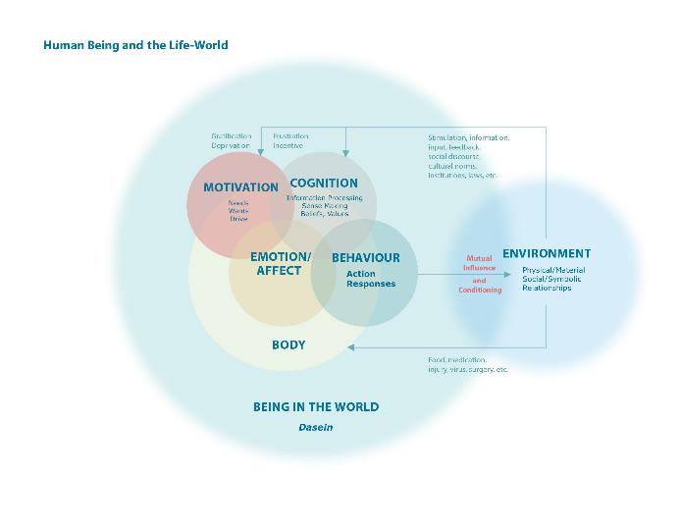
SSLD
Framework
Environment
Body
Motivation
Cognition
Emotion
Behavior

Slide 18
Being-in-the-World
Conventional Metaphysical Frame | SSLD
 | Analytic Domains | Holistic Formulations
Social | Environment | Being/Selfhood/Identity Existential Spiritual Aesthetic Membership
Biological | Body
Psychological | Motivation
 | Cognition
 | Emotion
 | Behavior

Slide 19
SSLD Holistic Formulations | SSLD Analytic Domains | Specific Components
Being/Selfhood/Identity Existential Spiritual Aesthetic Membership | Environment | Physical/Material Social/Symbolic (includes relationships)
 | Body | Physical/Biological + Embodiment + Social construction
 | Motivation | Needs, Wants, Drive
 | Cognition | Information processing, making sense + beliefs, values + purpose + sense of self (not just memory and intellectual functioning)
 | Emotion | Emotional state + Emotional trait + Mood + Relational feelings
 | Behavior | Action + Articulation/Communication + Reflexes/Involuntary(e.g., stereotypic)

Slide 20
What Happens in SSLD?
Through systematic learning, the child can master effective agentive, interpersonal and social strategies and skills. These will lead to need gratification, displacing the original symptoms.
In SSLD, the child does not only learn specific skills (e.g., eye contact, verbal requests) but also learns how to learn – imitation, observation learning, and symbolically mediated learning
SSLD learning is grounded in real life, involving people in the child’s life world (parents, siblings, peers)

Slide 21
Replacing Problem Behavior
ASD
Problem Behaviour
Strategies & Skills
Observation
Learning Skills
Stereotypic
Repetitive
Behavior
Needs/Goals
Interpersonal
Interaction
Agency
Affiliation
Pleasurable Stimulation
Control/Mastery
Order
Emotional
Regulation
Withdrawal, isolation
Instrumental
Skills

Slide 22
Special Features of SSLD
Learning how to learn: emphasis on observation learning (including symbolic mediation) as the most important mode of human learning
Focus on behavior, yet connecting it with the key domains of human experience and environmental realities
Individualized and systematic learning of adaptive skills and strategies
The child comes before the structure or system, which is used to facilitate the child’s learning. We modify the structure to suit the child, not the other way around.

Slide 23
Special Features of SSLD
Multiple contingencies thinking: Program design takes into consideration of the child’s circumstances and needs, developmental status,
Comprehensive attention to all domains: biology, motivation, emotion, cognition, behavior, and environment
Maximize opportunity, time, and space for learning
  Mobilize family and people in the child’s life,
  Empowering parents through parallel learning program
Grounded in real life – minimize the difficulty of learning transfer
Pragmatism: Eclectic inclusion of other methods

Slide 24
If you want to learn more about SSLD
You can visit our website at
http://ssld.kttsang.com/

