Slide 1
Mapping out the Clinical Change Process
A. Ka Tat Tsang
2013/06/30

Slide 2
Clinical Change Process
Built on Wolberg’s (1986) mechanic of therapeutic change (pp. 450-457)
Pre-Encounter
Presentation and Alliance Building
Exploration and Collaborative Sense-Making
Replacing Dysfunctional Patterns
Achieving Positive Clinical Outcome

Slide 3
I. Pre-Encounter
Client goes through a process of help-seeking decision making and action. Part of this is directed inwards (e.g., what is my problem, do I want to seek professional help). Part of this is directed outwards (researching, shopping, seeking referral/admission).
Practitioner works within a service setting, that has its community profile established through public presentation (e.g., branding, location, décor, website, literature, fee charging, receptionists and customer service interface, etc.) and references (by professional colleagues, current and former clients, partners, community members) .

Slide 4
II. Presentation and Alliance Building
The client meets the practitioner, and starts the process of engagement
The client presents a problem situation (complaints, subjective dis-ease, crisis, symptoms) through clinical narratives.
Such narratives are co-constructed within the context of client-practitioner interaction.
A positive relationship or alliance emerges as the practitioner demonstrates understanding, acceptance, and collaboration.

Slide 5
III. Exploration and Collaborative Sense-Making
The practitioner will explore the client’s circumstances and personal experience. This usually requires the creation and maintenance of an open and safe
Practitioner brings in a conceptual framework (clinical practice theory) to guide and facilitate the exploration. This framework or theory will also enable the client-practitioner dyad to make sense of the client’s situation and issues.
Through clinical interaction, the client begins to identify patterns (motivational, cognitive, emotional, or behavioral) believed to be responsible for producing and/or maintaining the problem(s).

Slide 6
IV. Replacing Dysfunctional Patterns
The client begins to examine and question the value of dysfunctional motivational, cognitive, emotional, and behavioral patterns.
The client explores new alternatives. This is sometimes associated with a more or less deliberate attempt to stop old dysfunctional patterns.
Initial experimentation with new patterns brings positive change (increased mastery of internal processes and/or the environment, improved interpersonal and/or social functioning).

Slide 7
V. Achieving Positive Clinical Outcome
Finding personal gratification in these changes. The client becomes increasingly motivated and able to dissociate from old patterns and to adopt new strategies.
The complaints, problems, or symptoms initially presented are significantly decreased according to objective measure and/or subjective appraisal.
Positive changes in interpersonal and social functioning associated with a growing sense of mastery and strength (self-efficacy).
The client feels self-sufficient and is ready to terminate treatment.

Slide 8
Being-in-the-World
Gratification
Deprivation
Frustration
Incentive
Stimulation, information, social discourses, input, feedback
Cognition
Information
processing,
Making-sense
Beliefs, Values
Attitude
Behaviour
Action
Response
Motivation
Drive
Needs
Desire
Environment &
Social Reality
Emotion/
Affect
Mutual Conditioning & Transformation
Biology
Food, medication, injury, virus, surgery, cultural norms, institutions, laws, etc.

Slide 9
6 Domains of the Clinical Change Process
Cognition | Emotion | Behavior | Motivation | Body | Environment

Slide 10
6 Domains of the Clinical Change Process
Cognition | Emotion | Behavior | Motivation | Body | Environment | Working Alliance

Slide 11
Cognitive Change
Cognitive Structures
Worldview | How does the client view the world (objective/physical world, social reality, interpersonal relationship)? Is the world experienced as safe, dangerous, orderly, chaotic …?
Social scripts | Life scripts: What one should be doing in different phases of life Social norms: Values, morality, gender roles, etc.
Self-concept | Self knowledge and understanding: Character, strength/weakness Self esteem: Others as reference, grounded in self Identity, social location, relationship with the social order

Slide 12
Cognitive Change
Cognitive Style
Fixed, rigid Extreme, polarized Categorical Negative External locus of causation/control | ➔ ➔ ➔ ➔ ➔ | Contingent, variable, flexible Moderated, scaled, Dimensional Positive ➔ Nuanced Internal locus ➔ Integrated/ balanced view

Slide 13
Emotional Change
Create/maintain a safe space, allowing exploration of feelings
Awareness, identification/recognition, getting the felt-sense, bodily sensation, experiencing, mindfulness
Making sense and internal articulation (includes: naming, labeling, describing, symbolization, metaphors)
Ownership (can move through dis-identification)
Expression: Private or interpersonal, verbal or non-verbal
Restoring equilibrium: Discharge, channeling, ventilation or catharsis
Self-acceptance – mastery and self-efficacy
Resolution, transformation, reconstruction (conflict, ambivalence, trauma) – often involves cognitive processing
Notes:
Nicolaus Copernicus (1473-1543) proposed his heliocentric theory in his book De revolutionibus orbium coelestium (On the Revolutions of the Celestial Spheres), which was published before his death.

Slide 14
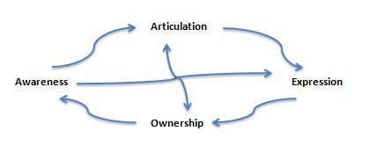
Emotional Change
Equilibrium

Slide 15
Emotional Change
These processes do not always follow a step and step linear sequence.
Awareness, articulation, ownership, and expression can all feed into each other.
The “resolution” of one emotional issue can prepare us for engaging with another related issue.

Slide 16
Motivation
Awareness, acceptance, and in-corporation
Unaware of needs and drives (repression, lack of awareness, lack of access)
Emerging awareness, negotiation
Awareness
Acceptance and ownership
Volition
Excessive or deficient ➔ Appropriate
  (in relation to the person’s N3C: Needs, Circumstances, Characteristics, Capacity)

Slide 17
Behavior
Ineffective Inappropriate Involuntary Ego-dystonic | ➔ ➔ ➔ | Effective Appropriate (in relation to the person’s N3C) Agentive Ego-syntonic

Slide 18
Body
Dis-ease | ➔ | At ease
Otherizing, Objectification | ➔ | Joining, Embodiment
Inhibition | ➔ | Spontaneity, freedom, flow
Rejection, exclusion | ➔ | Acceptance
Neglect | ➔ | Interest, curiosity, attention
Ignorance | ➔ | Knowledge, understanding
Take-for-granted | ➔ | Consciousness, care
Abuse | ➔ | Value, respect
Preoccupation | ➔ | Transcendence (let go, go beyond)
Notes:
China 'to overtake US on science' in two years
David Shukman
http://www.bbc.co.uk/news/science-environment-12885271
28 March 2011 Last updated at 21:28 GMT

Slide 19
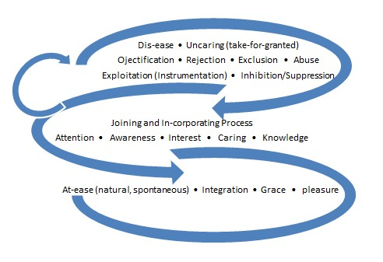
Body
Notes:
http://en.wikipedia.org/wiki/List_of_countries_by_research_and_development_spending

Slide 20
Environment
Environment experienced as external, given (negative, privative, hostile, unsafe): Fear, helplessness, vulnerability, isolation
Awareness of how the environment is constructed or produced socially and personally
Awareness of interactive relationship between self and environment: Sense of agency, mastery, efficacy, responsibility
Material and social/symbolic realities are changed as a result of agentive acts

Slide 21
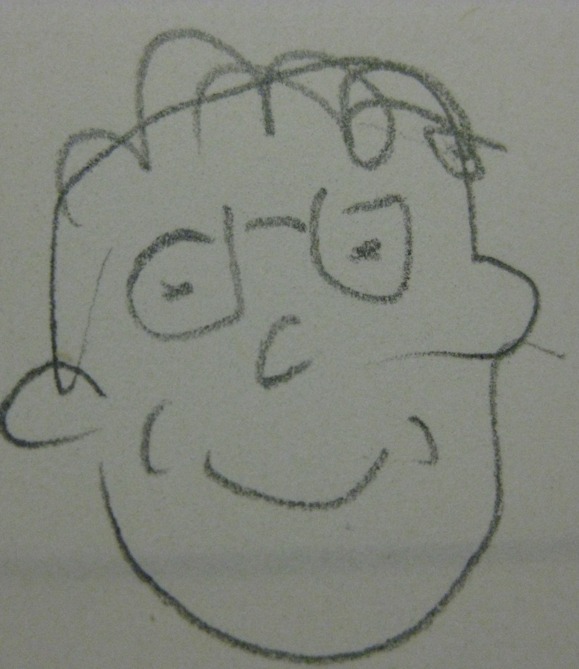
My contact: k.tsang@utoronto.ca

